Slide 1
The 6th Amendment
“In all criminal prosecutions, the accused shall enjoy the right to a speedy and public trial, by an impartial jury of the State and district wherein the crime shall have been committed…and to be informed of the nature and cause of the accusation; the accused shall be confronted with the witnesses against him; the accused shall have compulsory process for obtaining witnesses in his favor, and to have Assistance of Counsel for his defense.”
1. Why do you think the writers of the Constitution believed it was necessary for criminal trials to be both “speedy and public”?
2. What do you think is the significance in requiring that a criminal trial take place in the state/district where the crime occurred?
3. Why do you think the writers placed the responsibility of determining the innocence or guilt of a suspect in the hands of a jury?
4. What do you think is meant by an accused individual’s right to “be confronted by witnesses” and “obtaining witnesses in his favor”?
5. Why do we have the right to Assistance of Counsel for our defense during a trial?

Slide 2
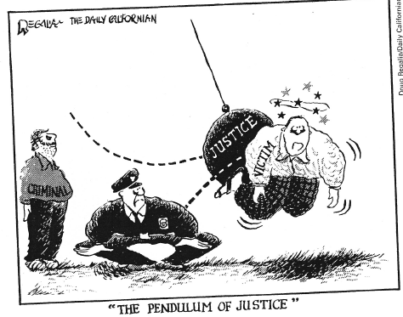
Who do the three figures in the cartoon represent?
A pendulum swings back and forth without stopping. What is the importance of the swinging pendulum in the cartoon?
What is happening to the victim?
What is the relationship between the figure in the middle and the one on the right?
Why do you think many people believe the scales of justice are tipped unfairly in the direction of criminals in this country?

Slide 3
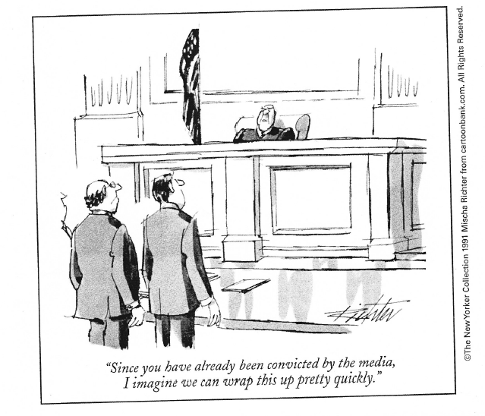
Who are the two people standing before the judge?
Which amendment would prevent the situation described in this cartoon from happening?
Which are the two provisions of the Constitution which would protect the rights of the person in the cartoon?
Do you think that the rights of the media to cover trials impact the rights of the accused to a fair trial?

Slide 4
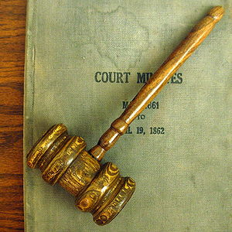
Criminal Justice Process – Trial & Rights of the Accused

Slide 5
DON’T FORGET!!
Criminal trials MUST be conducted with “due process”
Due Process = “equal treatment” under the law
These words are found in both the 5th and 14th Amendments of the Constitution
ALL Americans are entitled to due process if they are accused of a crime

Slide 6
Trial Procedures
By Jury
1) guaranteed by the 6th Amendment
2) Jurors can be selected by:
Voter registration
Tax lists
Drivers’ licenses

Slide 7
Trial Procedures (cont’d)
3) criminal juries are usually composed of 12 people
4) a defendant can waive (give up) right to a jury trial and instead the trial will be heard in front of a judge (known as a bench trial)

Slide 8
Trial Procedures (cont’d)
A “Speedy & Public Trial”
1) speedy = a short time limit between the arraignment, grand jury hearing, and trial is guaranteed (can be waived)
2) public = proceedings of a trial must be made available to the public and/or media
Some judges will allow for television cameras to record the proceedings of the trial. However, even if the judge bars the media from recording the event in real time, the daily events must be released to the public as soon as business for the day concludes.

Slide 9
Trial Procedures (cont’d)
Compulsory Process and Confronting Witnesses
1) defendant can subpoena (get a court order) to compel a witness to testify on defendant’s behalf
2) failure to serve your subpoena will result in you being charged with crime of contempt (not allowing justice to proceed)
A sample subpoena from New Jersey civil court. A similar one could be used for criminal court.

Slide 10
Confronting Witnesses (cont’d)
3) You are allowed to cross-examine any witness that the prosecution calls on their behalf; they can do the same to your witnesses
4) the goal of cross-exam is to find contradictions in the witness’s testimony to establish guilt or reasonable doubt
Dr. Melinda Warner from SVU being cross-examined on the witness stand

Slide 11
Confronting Witnesses (cont’d)
5) Some witnesses are granted immunity by the prosecution when they are on the stand
Witness answers incriminating questions about themselves with the goal of linking the defendant to the crime
Witnesses’ testimony cannot be used against him/her in a later trial
More than likely, immunity is part of a plea bargain
In the movie The Usual Suspects, Kevin Spacey’s character Roger “Verbal” Kint is granted total immunity in exchange for his cooperation with the LAPD

Slide 12
Trial Procedures (cont’d)
Right to legal Counsel
1) every defendant has the right to an attorney to argue a case for them (can be waived)
2) In the case of Gideon v. Wainwright, the Supreme Court acknowledged that if a defendant was too poor to afford an attorney, they should receive one for free
Clarence Earl Gideon’s case proved that one man can change the Constitution!

Slide 13
Dr. Sam Sheppard

